Slide 1
WELCOME!!!

Slide 2
During this lesson you will learn to use smalls units of English that will be useful to build up sentences, paragraphs, essays etc. Besides you will learn basic topics as the alphabet and the numbers. So the topis are:
Alphabet pronunciation
Articles
Nouns
Personal pronouns
Possesive adjectives
LET´S START…

Slide 3
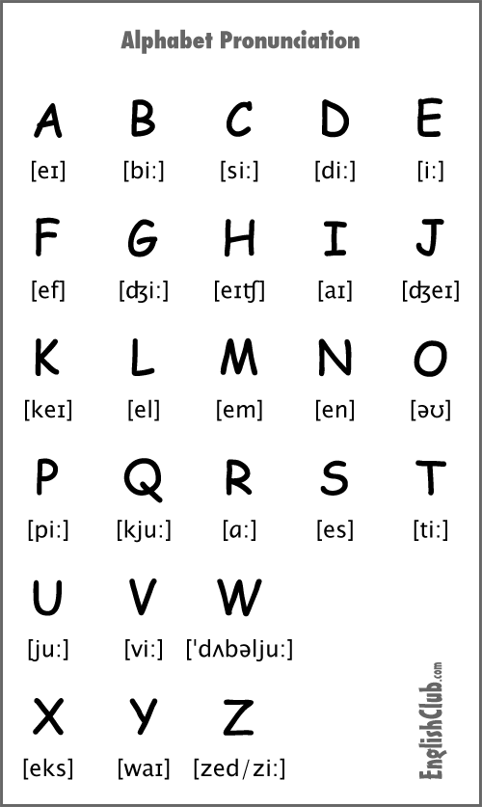

The Alphabet

Slide 4
ARTICLES
There are two types of articles:
Definite article: THE , it means in spanish EL, LA , LOS LAS. It is used in the following situations:
* Unique things. Example The sun
Specific thing. Example I like THE flowers of your garden
Family names. Example The simspons
Groups of islands
Musical instruments. Example the piano
Organizations and names of hotels . Examples The Red Cross
Rivers, oceans , deserts
Groups of mountains
DONT USE IT
Name colors, subject, sports, days of the week,
Name general things. Example I like dogs
Names of people
Names of single islands
Names of countries except from USA and UK

Slide 5
ARTICLES
2. Indefinite articles: They are A and An. They mean UN Y UNA in spanish.
A is used when the word begins with consonant
An is used when the word begins with a vowel
EXCEPTIONS
* When the word begins with ¨» h» and the h doesn´t sound, so you use AN. Example AN HOUR
When the word begins with «h» and the h sounds so you use A.
Example A HOSPITAL
When the U sound «you» Example A university
When the U sounds «A» Example An umbrella

Slide 6
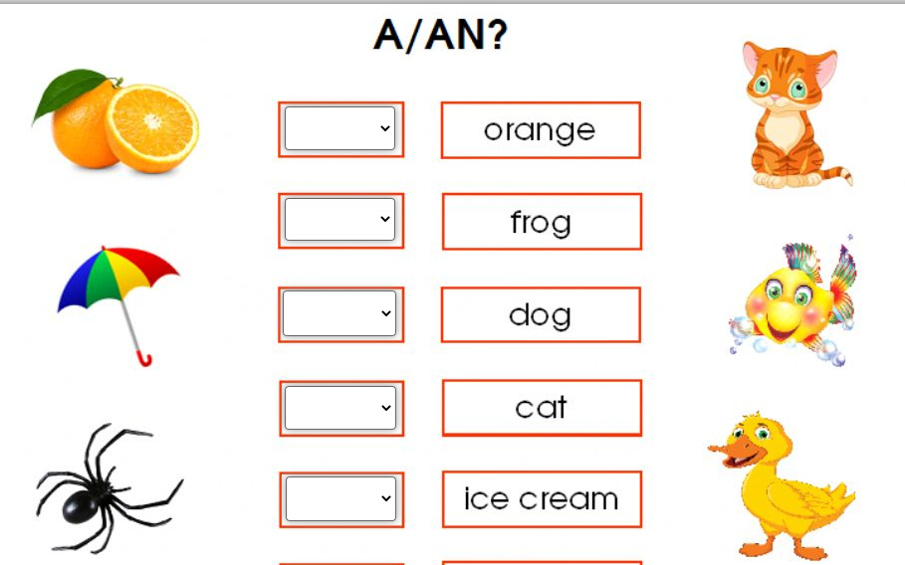
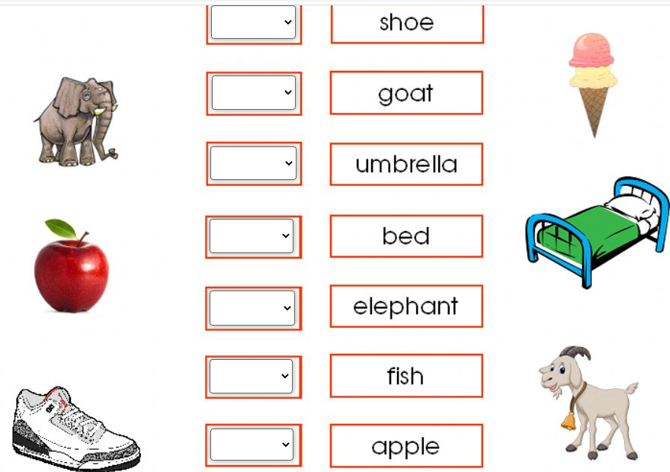
let´s practice

Slide 7
PLURAL NOUNS
A noun is a word to refer to an objetc, animal, person or thing. Example
House, dog, girl, computer
When you learn English is very important to learn how to make nouns plural. So follow the following rules.
Most nouns add S to the noun. Example:
desk= desks car= cars cat= cats computer= computers
2. For nouns ending in S, Z,X ,CH, SH add ES. Example
Class= classes Quiz= quizes watch= watches
3. For nouns ending in F, change F to V and ES. Example
Wife= wives leaf = leaves
4. For nouns ending in consontan + Y. Change Y to IES. Example
Story= stories

Slide 8
PLURAL NOUNS
5. For nouns ending in vowel + Y, only add S. Example
Toy= toys
6. Nouns like tomato and potato, add es. Example potatoes and tomatoes
7. There are some nouns called irregular nouns. You don´t add S or Es. You only use the word that aleady exist in plural. They are
PERSON = PEOPLE
CHILD= CHILDREN
MAN= MEN
WOMAN= WOMEN
MOUSE= MICE
FOOT= FEET
TOOTH= TEETH

Slide 9
let´s practice
Dish
Goat
Peach
Chair
Box
Woman
Baby
Fly
Wish
Shelf
Tooth
child

Slide 10
PERSONAL PRONOUNS
They are 8 personal pronouns in English, you use them to indicate the subjetc in a sentence. They are
I = yo
You = usted
He= él
She= ella
It= eso
You= ustedes
We= nosotros
They= ellos

Slide 11
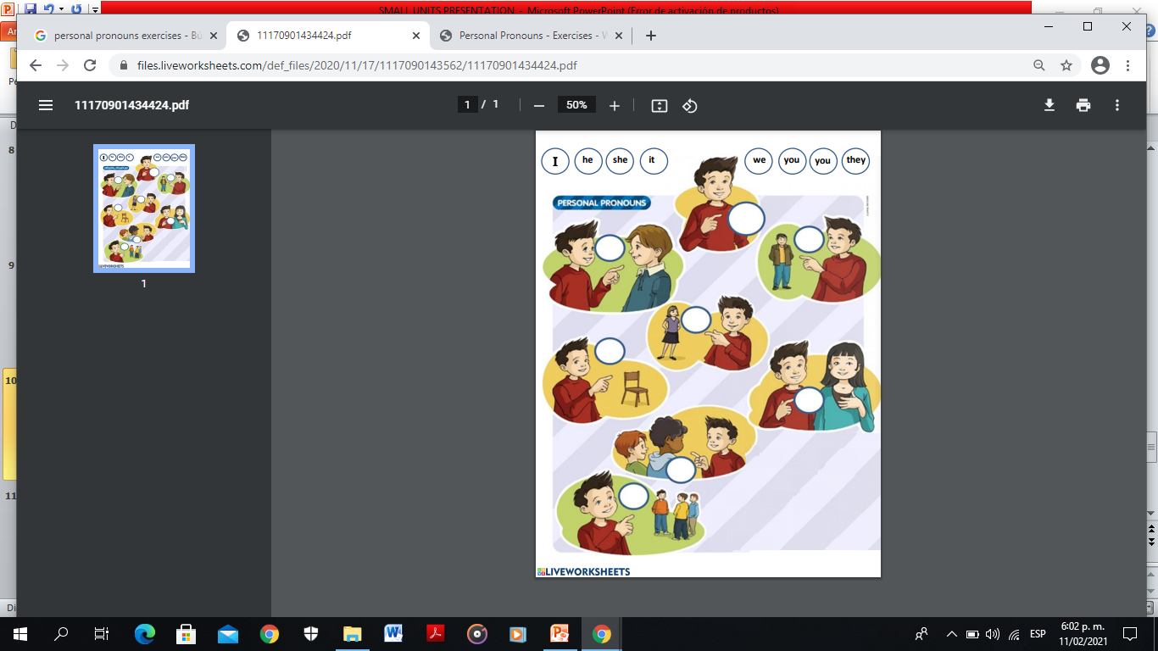

Slide 12
POSSESIVE ADJECTIVES
Possesive adjectives are used to indicate possesion, each personal pronoun has its own possesive adjectives. It depends on the person who own the object
My = mi
Your= su ( de usted)
His = su ( de él)
Her = su ( de ella)
Its = su ( de eso)
Your = su ( de ustedes)
Our = nuestro
Their = de ellos

Slide 13
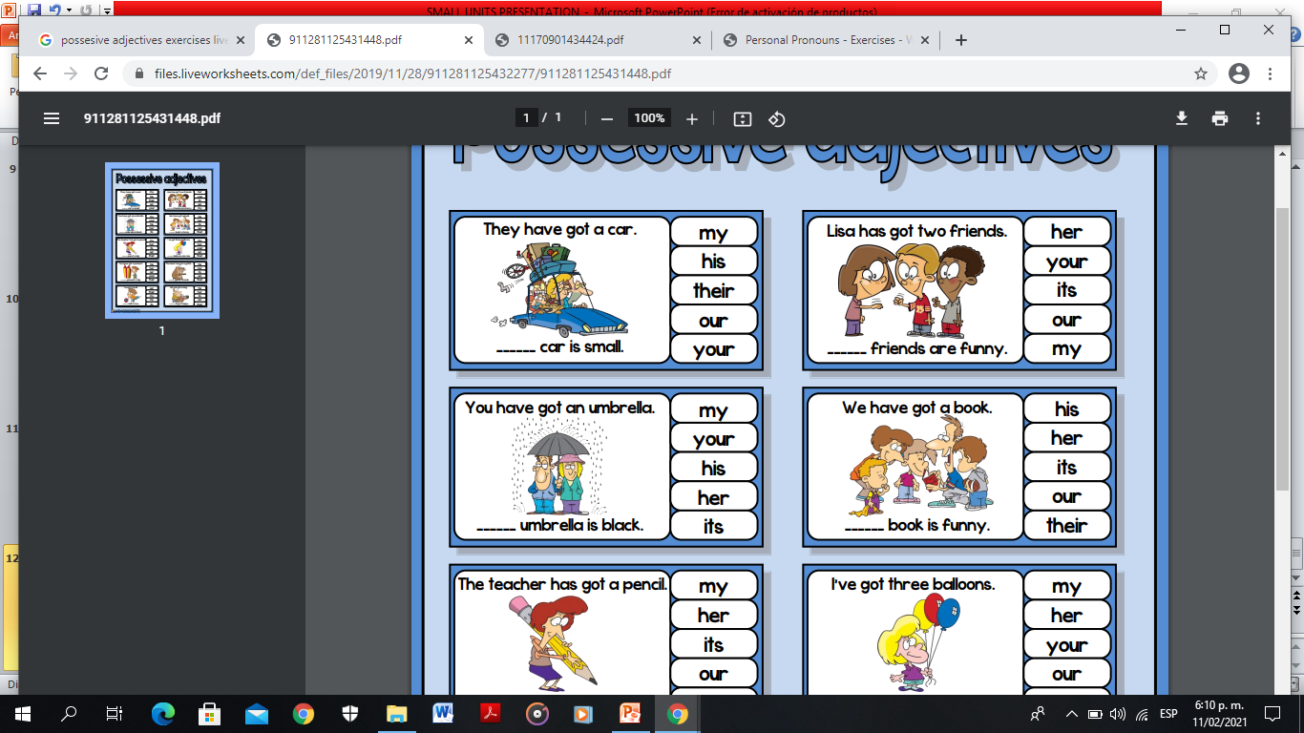

Slide 14
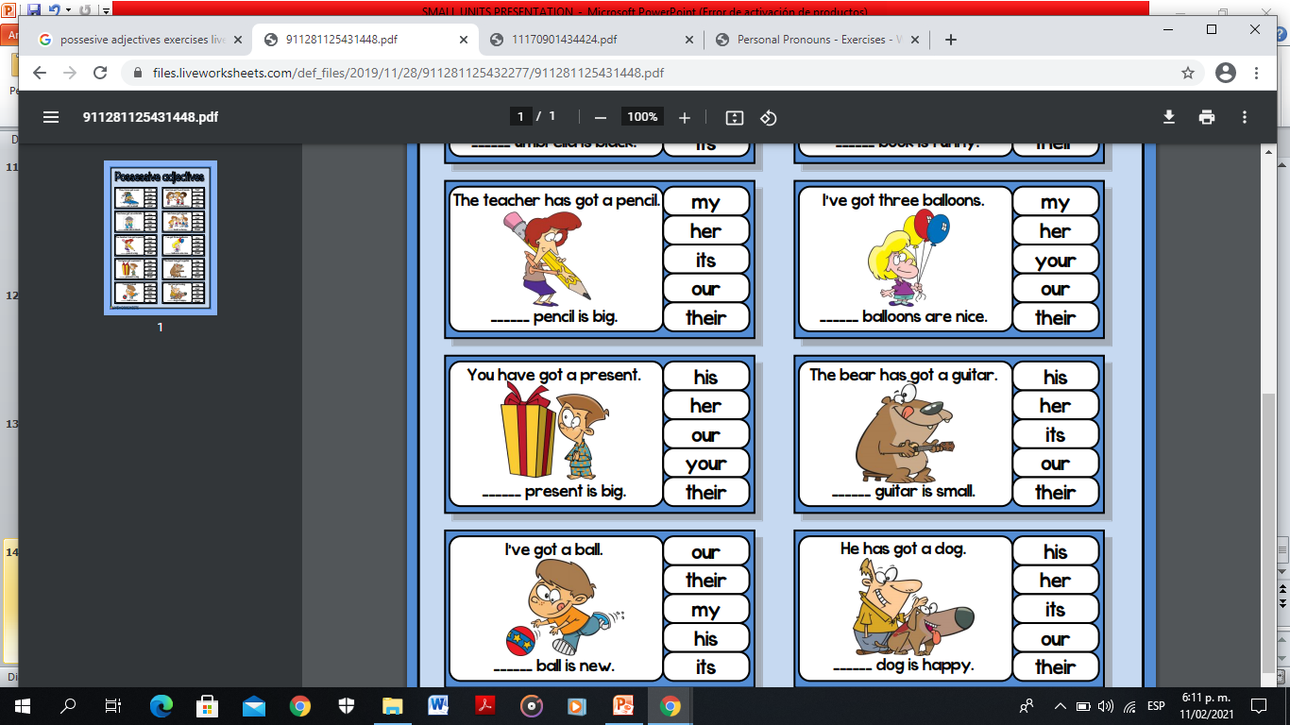

Slide 16
